Slide 1

Models for Messy Data
Steve Elston
Copyright 2018, 2019, 2020, 2021, 2022, 2023 2024, 2025, Stephen F Elston. All rights reserved.

Slide 2
Welcome to the Second Half of CSCI E-83!
Plan going forward:
Week 8, Oct 23: Statistical Properties of Time Series
Week 9, Oct 30: Introduction to Time Series Models
Week 10, Nov 6: Introduction to Bayes Models
Week 11, Nov 13: MCMC for Bayes
Week 12, Nov 20: Hierarchical Bayesian models
Nov 24: Project proposals due
Nov 27: No class, Thanksgiving holiday
Week 13, Dec 4: Modern Time Series Models or TBD
Dec 19: Submit Graduate Independent Projects – No extension possible!
Let me know if you have suggestions to update this schedule

Slide 3
Linear Model Assumptions
There are a number of assumptions in linear models that you overlook at your peril!
The feature or predictor variables should be independent of one another
This is rarely true in practice
Multi-colinearity between features makes the model under-determined
We assume that numeric features or predictors have zero mean and about the same scale
Zero-center predictors to get interpretable estimates of regression coefficients
We do not want to have predictors with a large numeric range dominate training
Example: income is in the range of 10s or 100s of thousands and age is in the range of 10s, but apriori income is no more important than age as a predictor
Values of each predictor or feature should be iid
If variance changes with sample, the optimal value of the coefficient could not be constant
If there is serial correlation in the predictor values, the iid assumption is violated - but can account for this such as in time series models

Slide 4
Introduction
Several commonly encountered data problems affect OLS and GLM models
Zero inflated response variables have an unusual number of zero values
Use a mixture model to switch between a binomial and another distribution
Over-dispersed response variables have a long tails
Can be asymmetric with long tails
Use heavy tailed distribution models
Apply models with mixtures of distributions to account for large low probability responses
Outliers in independent variables have an undue influence on OLS and GLM models
Robust regression models limit the influence of outliers on parameter estimates
We can extend the OLS and GLM frameworks to deal with these situations

Slide 5
Models for Zero-Inflated Response

Slide 6
Zero-Inflated Responses
Zero-inflated response variables arise in many situations
Most people who view an ecommerce site buy 0 products
Most auto drivers have no crashes per year
Most dental patients examined require 0 root canals
In much of the world the average rainfall amount on a specific day is 0
The number of sever weather events in a specific area per month is typically 0
In epidemiology the probability distribution of the of people contracting a disease per day has many zeros
Etc.

Slide 7
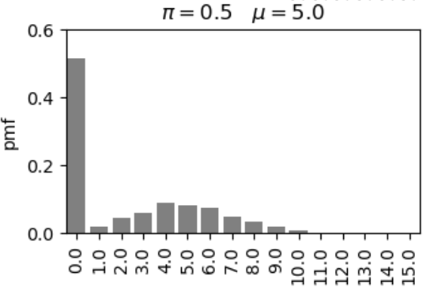
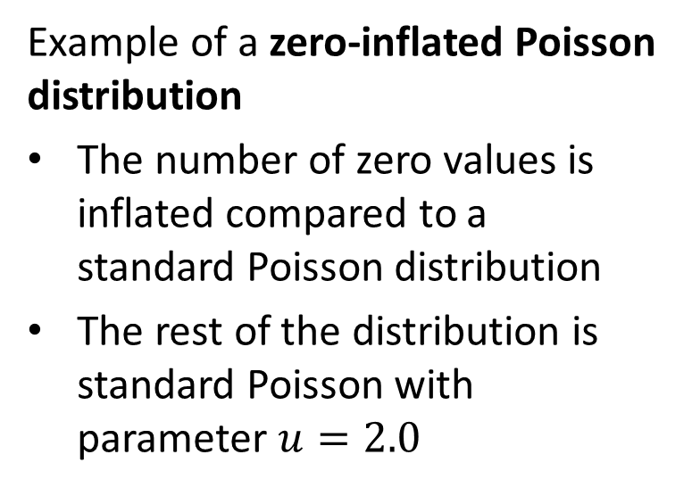
Zero-Inflated Responses
Example of a zero-inflated Poisson distribution
The number of zero values is inflated compared to a standard Poisson distribution
The rest of the distribution is standard Poisson with parameter $u=2.0$

Slide 8
Modeling Zero-Inflated Distributions
How can we model zero inflated distributions?
Standard ‘named’ distributions do not account for zero-inflation
Can use a mixture of two distributions
A binomial distribution, or switching distribution
A standard distribution
The binomial distribution serves as a ‘switch’ between 0 response and the other distribution

Slide 9
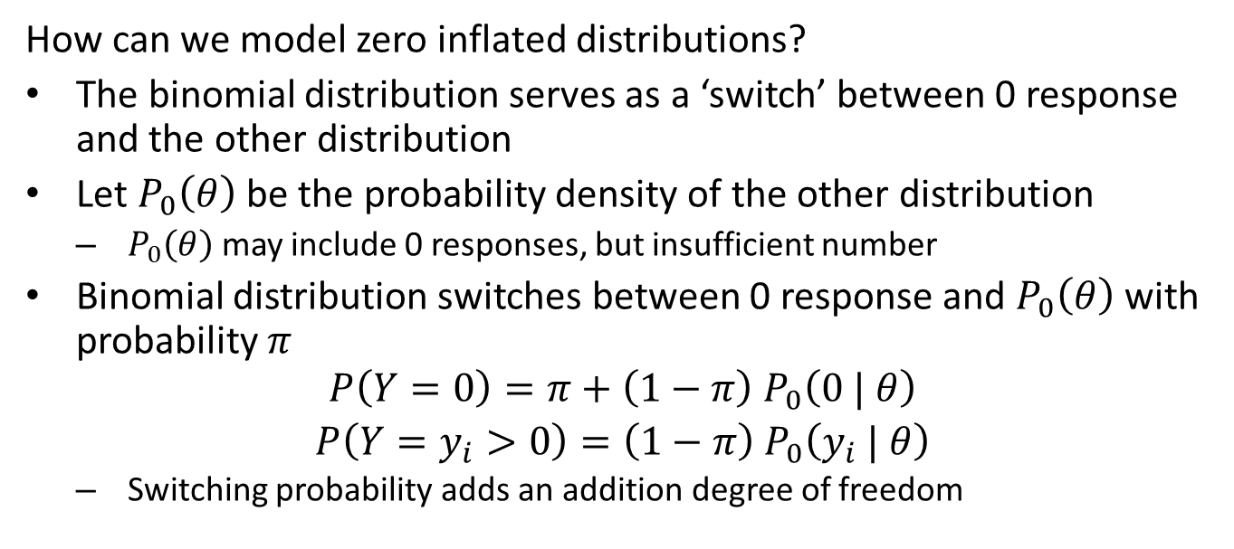
Modeling Zero-Inflated Distributions
How can we model zero inflated distributions?
The binomial distribution serves as a ‘switch’ between 0 response and the other distribution
Let $P_{0}\left(θ\right)$ be the probability density of the other distribution
$P_{0}\left(θ\right)$ may include 0 responses, but insufficient number
Binomial distribution switches between 0 response and $P_{0}\left(θ\right)$ with probability $π$
$$\begin{matrix}P\left(Y=0\right)=π+\left(1−π\right){ P}_{0}\left(0 | θ\right) \\ P\left(Y=y_{i}>0\right)=\left(1−π\right){ P}_{0}\left(y_{i} | θ\right)\end{matrix}$$
Switching probability adds an addition degree of freedom

Slide 10
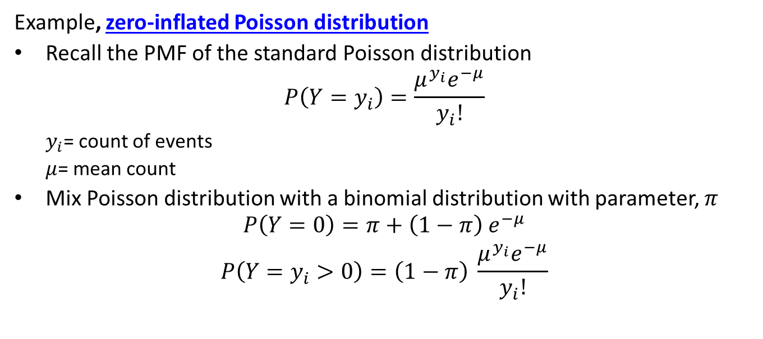
Zero-Inflated Poisson Distribution
Example, zero-inflated Poisson distribution
Recall the PMF of the standard Poisson distribution
$$P\left(Y=y_{i}\right)=\frac{μ^{y_{i}}e^{−μ}}{y_{i}!}$$
$y_{i}$= count of events
$μ$= mean count
Mix Poisson distribution with a binomial distribution with parameter, $π$
$$\begin{matrix}P\left(Y=0\right)=π+\left(1−π\right){ e}^{−μ} \\ P\left(Y=y_{i}>0\right)=\left(1−π\right) \frac{μ^{y_{i}}e^{−μ}}{y_{i}!}\end{matrix}$$

Slide 11
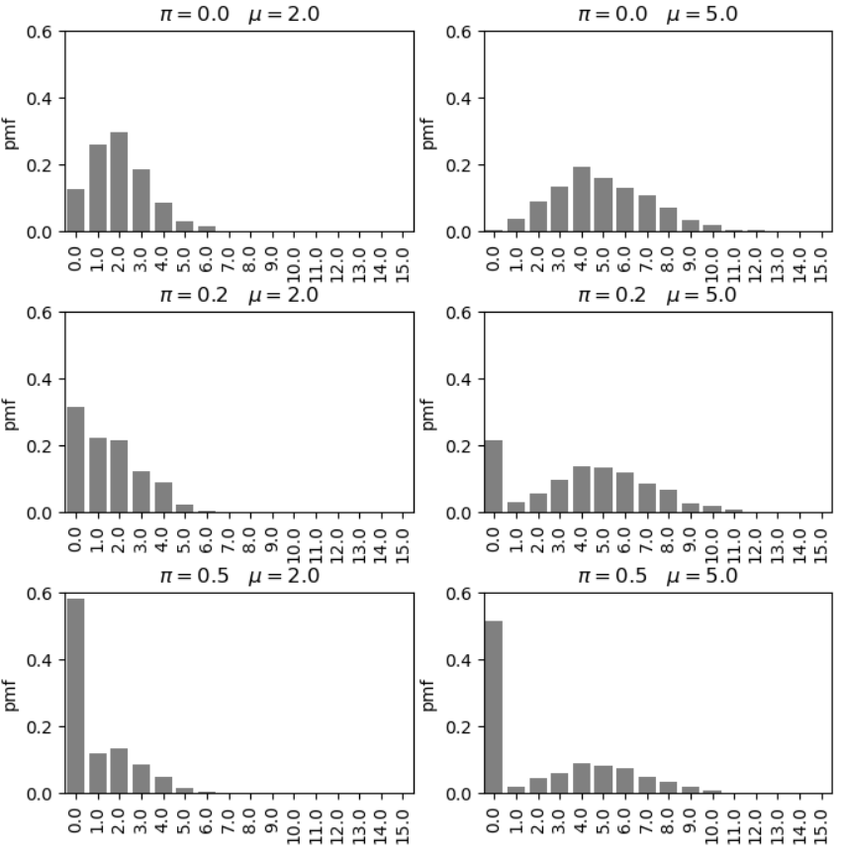
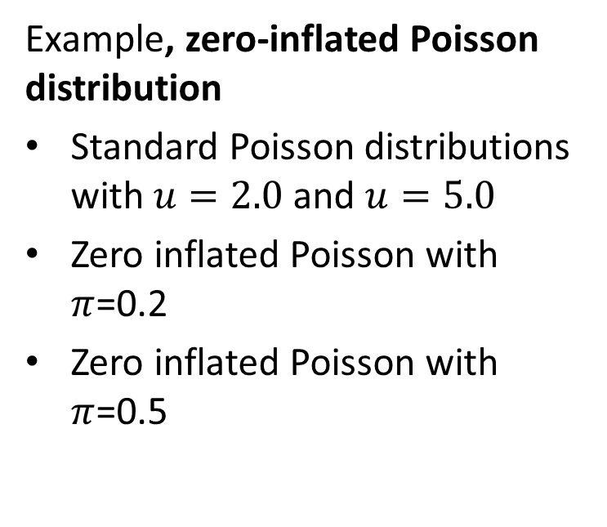
Zero-Inflated Poisson Distribution
Example, zero-inflated Poisson distribution
Standard Poisson distributions with $u=2.0$ and $u=5.0$
Zero inflated Poisson with $π$=0.2
Zero inflated Poisson with $π$=0.5

Slide 12
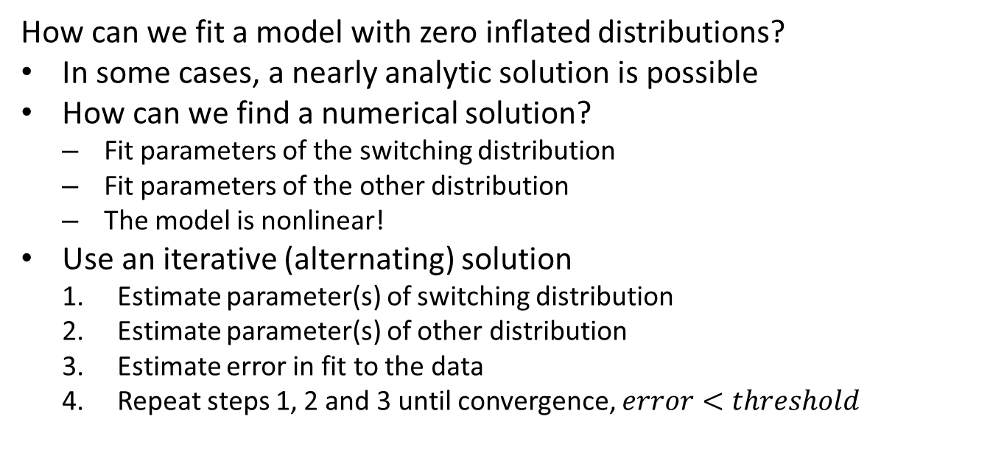
Zero-Inflated Response Regression
How can we fit a model with zero inflated distributions?
In some cases, a nearly analytic solution is possible
How can we find a numerical solution?
Fit parameters of the switching distribution
Fit parameters of the other distribution
The model is nonlinear!
Use an iterative (alternating) solution
Estimate parameter(s) of switching distribution
Estimate parameter(s) of other distribution
Estimate error in fit to the data
Repeat steps 1, 2 and 3 until convergence, $error<threshold$

Slide 13
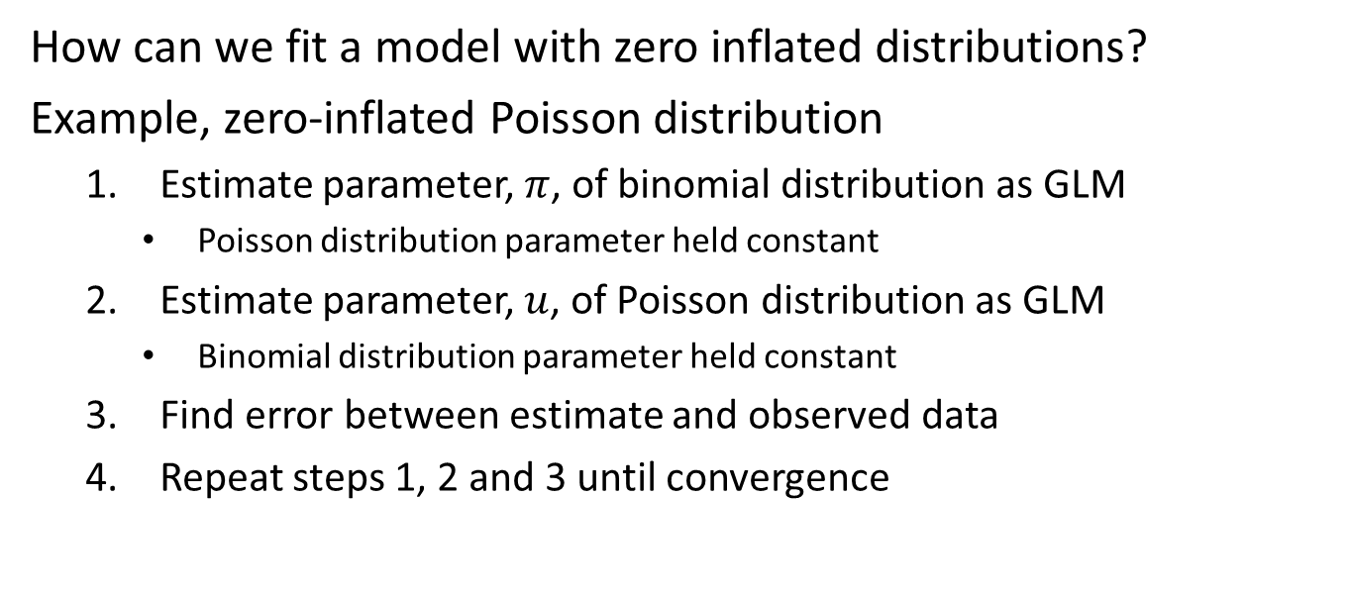
Zero-Inflated Response Regression
How can we fit a model with zero inflated distributions?
Example, zero-inflated Poisson distribution
Estimate parameter, $π$, of binomial distribution as GLM
Poisson distribution parameter held constant
Estimate parameter, $u$, of Poisson distribution as GLM
Binomial distribution parameter held constant
Find error between estimate and observed data
Repeat steps 1, 2 and 3 until convergence

Slide 14
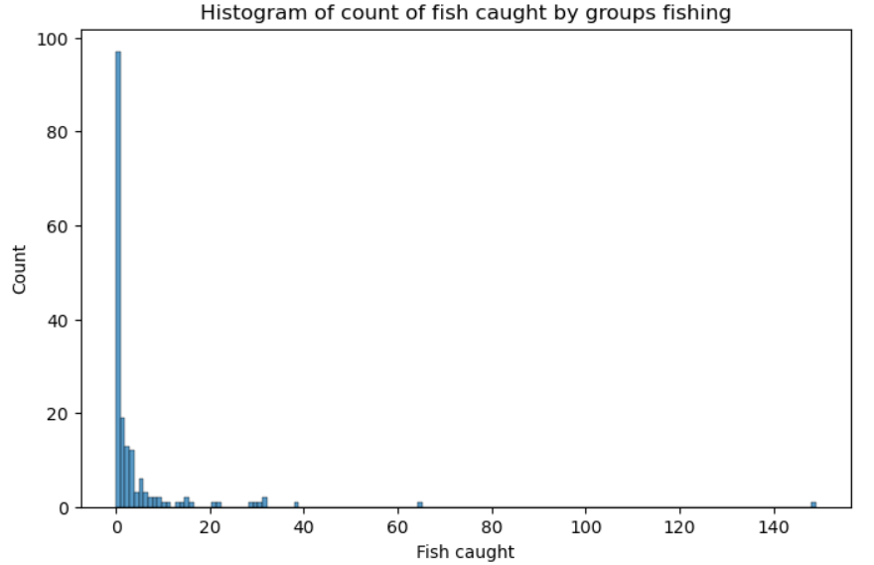
Example: Zero-Inflated Poisson Regression
Example: model for fish caught by parties visiting a park
The distribution is zero inflated, many parties do not catch any fish

Slide 15
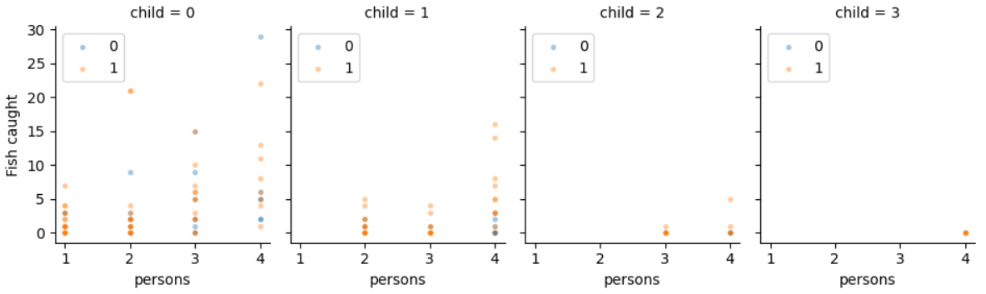
Example: Zero-Inflated Poisson Regression
Example: model for fish caught by parties visiting a park
Exogenous variables, persons in party, children in party, did the party camp
Facet plot of the response variable vs. the exogenous variables

Slide 16
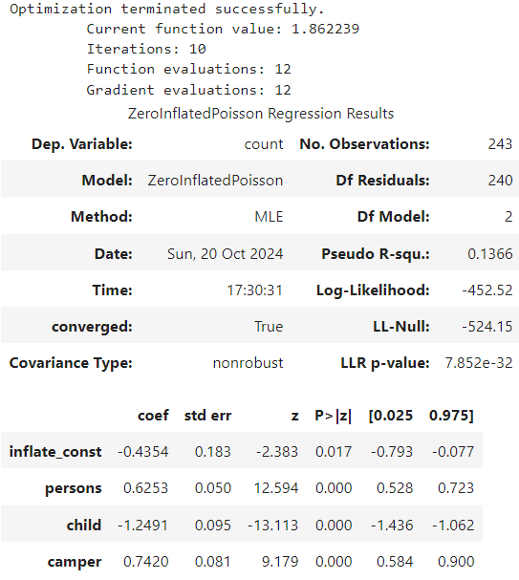
Example: Zero-Inflated Poisson Regression
Example: model for fish caught by parties visiting a park
Model is significant in explaining the data compared to the null model
The coefficients are all significant
Coefficient for switching
Adding people to party or camping increases expected number of fish caught
Children in party reduce expected number of fish caught

Slide 17
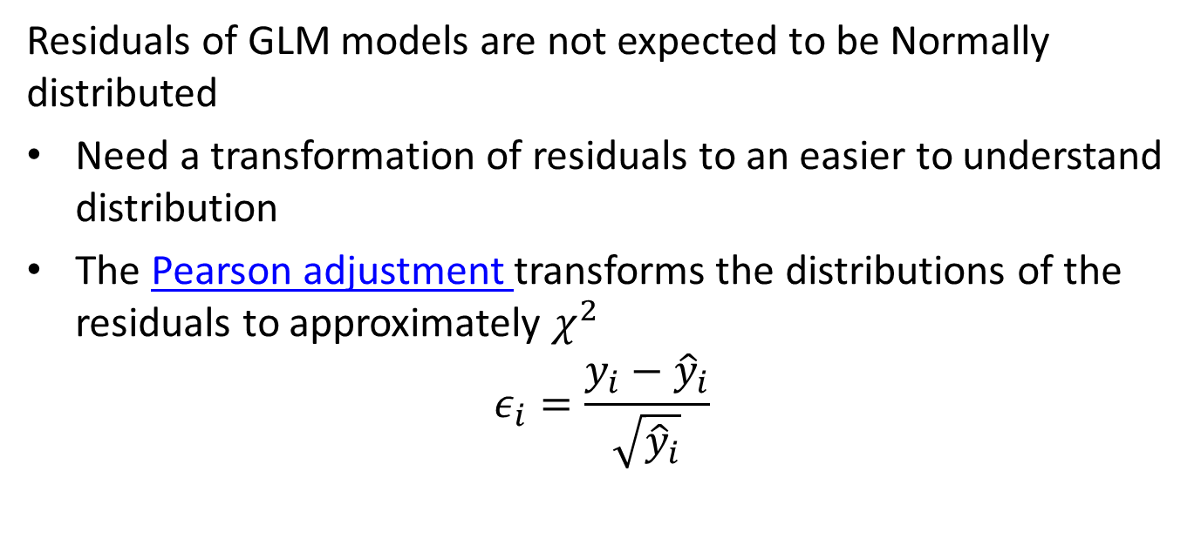
Example: Zero-Inflated Poisson Regression
Residuals of GLM models are not expected to be Normally distributed
Need a transformation of residuals to an easier to understand distribution
The Pearson adjustment transforms the distributions of the residuals to approximately $χ^{2}$
$$ε_{i}=\frac{y_{i}−{\hat{y}}_{i}}{\sqrt{{\hat{y}}_{i}}}$$

Slide 18
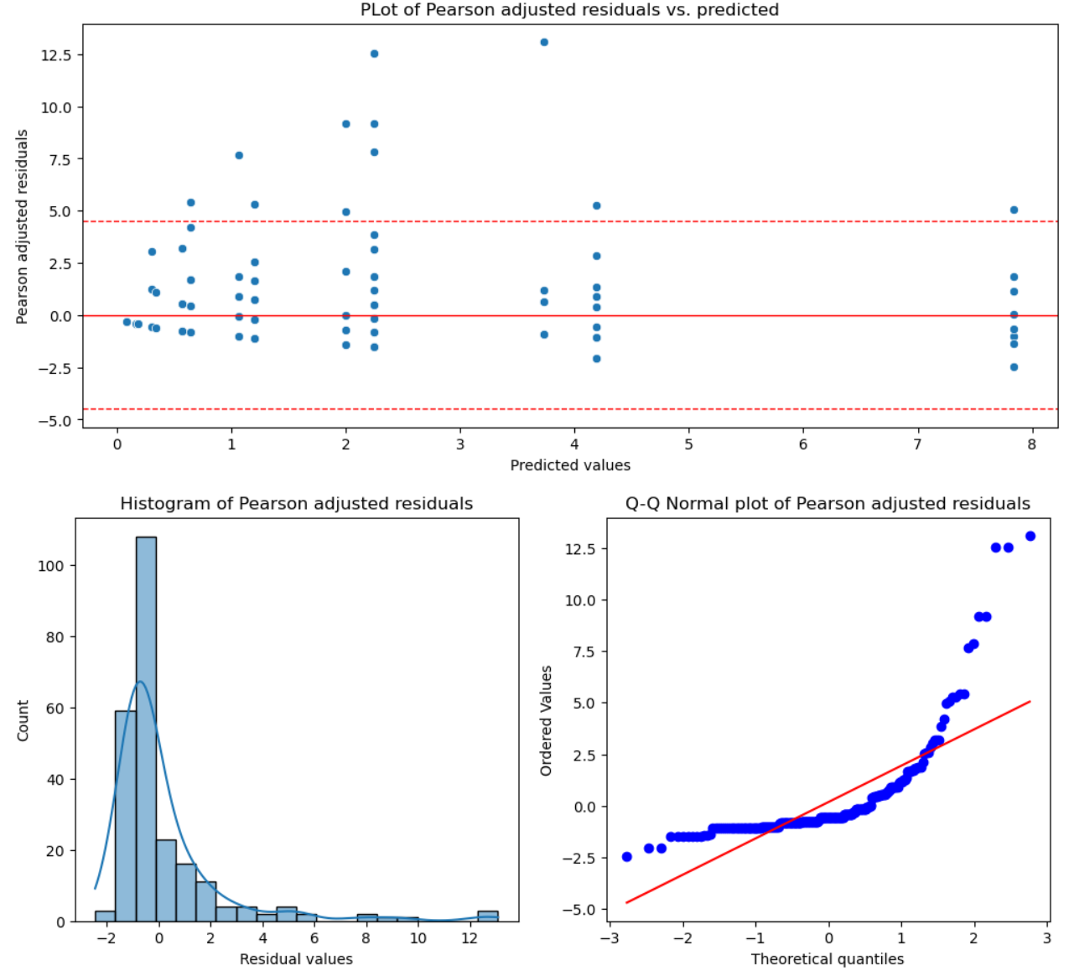
Example: Zero-Inflated Poisson Regression
Example: model for fish caught by parties visiting a park
Pearson adjusted residuals show some heteroscedastic behavior
Do not over interpret this plot!
A sample of only 250 cases is small and there can be considerable variation from sampling alone
Histogram and Q-Q plot show considerable right skew and larger outliers in the Pearson adjusted residuals

Slide 19
Models for Over-Dispersed Response

Slide 20
Over-Dispersed Response Distributions
Over-dispersed response variables are commonly encountered
Sales volume of a product can show have sudden surges
Demand on an electric grid can have extreme spikes beyond the mean load
Number of emergency patients seen at a hospital can surge well beyond the norm
Frequency of tornados is subject to outbreaks
Number of publications by academic researchers, where a few people have very high numbers
The daily trading volume of a stock can spike occasionally
In epidemiology, the number of people contracting a disease is generally low, but can spike to large numbers
Etc.

Slide 21
Modeling Over-Dispersed Distributions
How can we model over-dispersed distributions?
Two widely used options
Inherently heavy tailed distributions
Mixtures of distributions
Or both

Slide 22
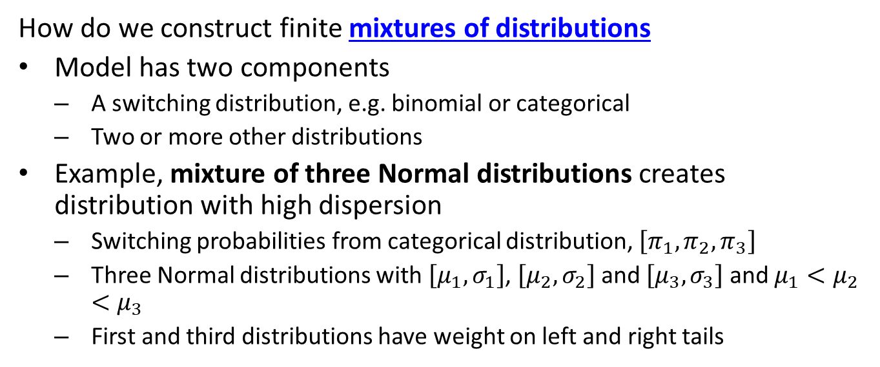
Modeling Over-Dispersed Distributions
How do we construct finite mixtures of distributions
Model has two components
A switching distribution, e.g. binomial or categorical
Two or more other distributions
Example, mixture of three Normal distributions creates distribution with high dispersion
Switching probabilities from categorical distribution, $\left[π_{1},π_{2},π_{3}\right]$
Three Normal distributions with $\left[μ_{1},σ_{1}\right]$, $\left[μ_{2},σ_{2}\right]$ and $\left[μ_{3},σ_{3}\right]$ and $μ_{1}<μ_{2}<μ_{3}$
First and third distributions have weight on left and right tails

Slide 23
Modeling Over-Dispersed Distributions
Many choices of heavy tailed distributions to model over-dispersed variables
Student-t with low degrees of freedom – cannot use GLM!
Negative binomial
Log-gamma
Pareto
Log-logistic
Log-normal
Etc.

Slide 24
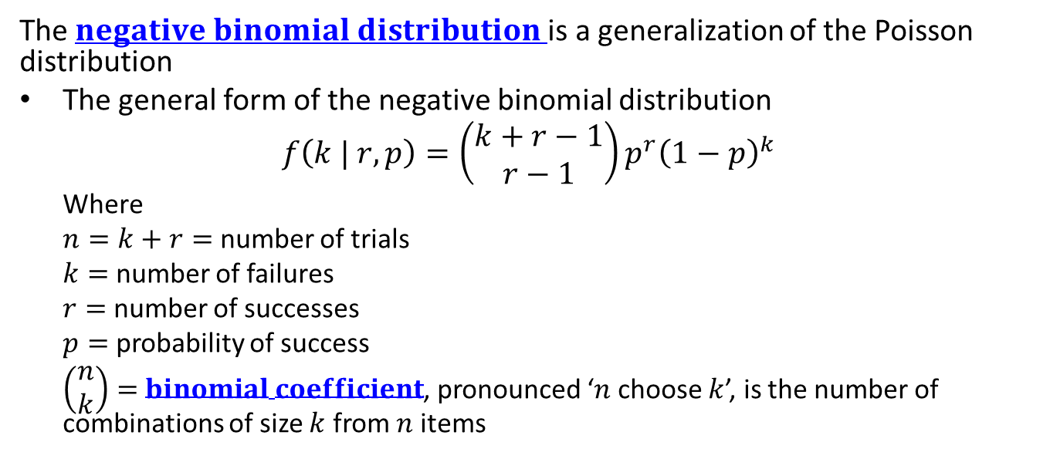
Negative Binomial Distribution
The $negative binomial distribution$is a generalization of the Poisson distribution
The general form of the negative binomial distribution
$$f\left(k | r, p\right)=\left(\begin{matrix}k+r−1 \\ r−1\end{matrix}\right)p^{r}{\left(1−p\right)}^{k}$$
Where
$n=k+r=$ number of trials
$k=$ number of failures
$r=$ number of successes
$p=$ probability of success
$\left(\begin{matrix}n \\ k\end{matrix}\right)=$ $binomial coefficient$, pronounced ‘$n$ choose $k$’, is the number of combinations of size $k$ from $n$ items

Slide 25
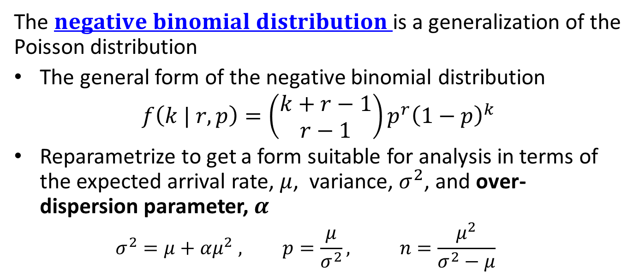
Negative Binomial Distribution
The $negative binomial distribution$is a generalization of the Poisson distribution
The general form of the negative binomial distribution
$$f\left(k | r, p\right)=\left(\begin{matrix}k+r−1 \\ r−1\end{matrix}\right)p^{r}{\left(1−p\right)}^{k}$$
Reparametrize to get a form suitable for analysis in terms of the expected arrival rate, $μ$, variance, $σ^{2}$, and over-dispersion parameter, $α$
$$σ^{2}=μ+αμ^{2} , p=\frac{μ}{σ^{2}}, n=\frac{μ^{2}}{σ^{2}−μ}$$

Slide 26
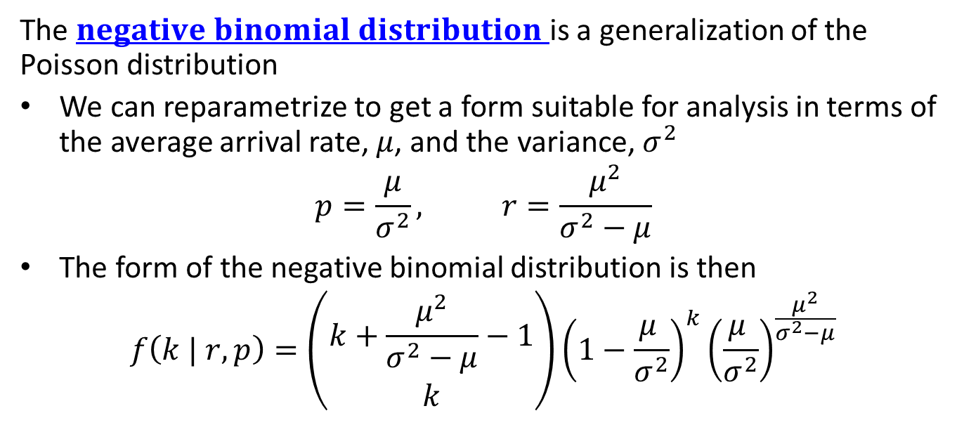
Negative Binomial Distribution
The $negative binomial distribution$is a generalization of the Poisson distribution
We can reparametrize to get a form suitable for analysis in terms of the average arrival rate, $μ$, and the variance, $σ^{2}$
$$p=\frac{μ}{σ^{2}}, r=\frac{μ^{2}}{σ^{2}−μ}$$
The form of the negative binomial distribution is then
$$f\left(k | r, p\right)=\left(\begin{matrix}k+\frac{μ^{2}}{σ^{2}−μ}−1 \\ k\end{matrix}\right){\left(1−\frac{μ^{ }}{σ^{2}}\right)}^{k}{\left(\frac{μ^{ }}{σ^{2}}\right)}^{\frac{μ^{2}}{σ^{2}−μ}}$$

Slide 27
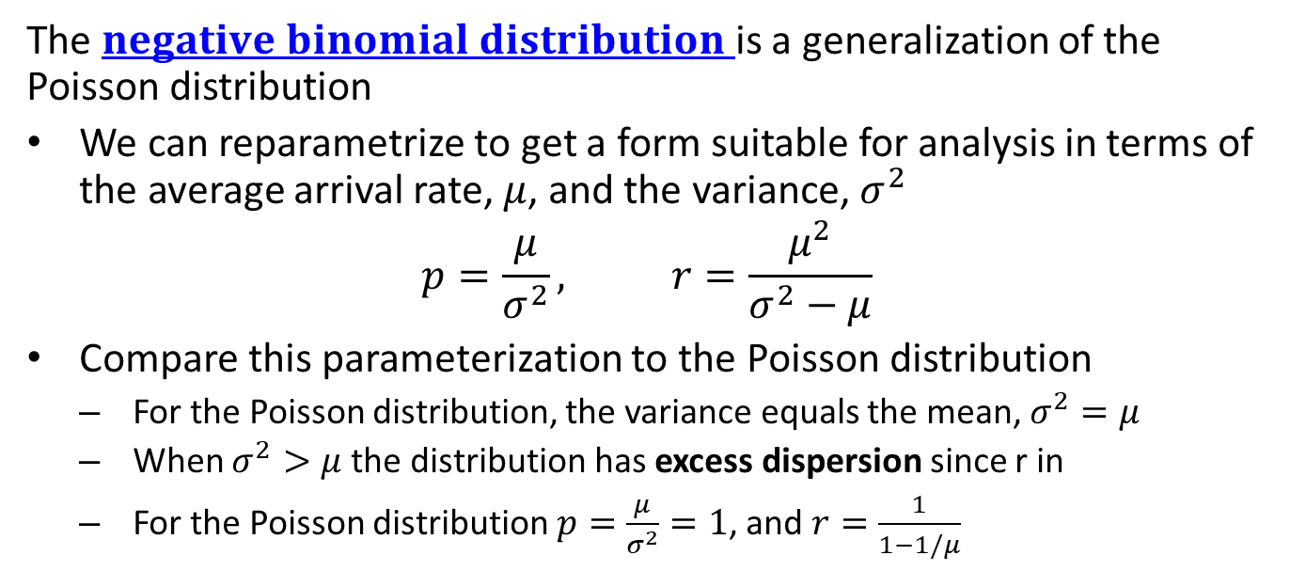
Negative Binomial Distribution
The $negative binomial distribution$is a generalization of the Poisson distribution
We can reparametrize to get a form suitable for analysis in terms of the average arrival rate, $μ$, and the variance, $σ^{2}$
$$p=\frac{μ}{σ^{2}}, r=\frac{μ^{2}}{σ^{2}−μ}$$
Compare this parameterization to the Poisson distribution
For the Poisson distribution, the variance equals the mean, $σ^{2}=μ$
When $σ^{2}>μ$ the distribution has excess dispersion since r in
For the Poisson distribution $p=\frac{μ}{σ^{2}}=1$, and $r=\frac{1}{1−1/μ}$

Slide 28
Zero-Inflated Over-Dispersed Distributions
How can we work with distributions that exhibit both zero-inflation and over-dispersion?
Create a mixture of two distributions
A binomial switching distribution for the zero-inflation
An over-dispersed distribution
Examples of zero-inflated and over-dispersed count data:
There are zero tornados on most days in most area, but can have large outbreaks with low probability
A wildlife biologist may spot none of a specific species on a given day, but could encounter large numbers occasionally
Most days there are no auto accidents on a segment of road, but there are a few days with high numbers of accidents
Demand for a rarely purchased product is zero on most days, but can have spikes in demand

Slide 29
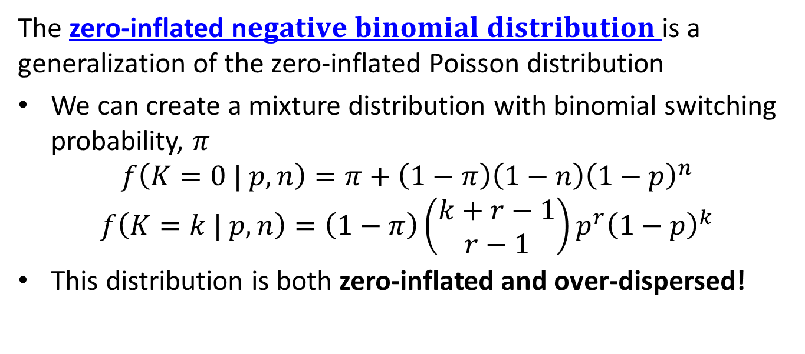
Zero-Inflated Negative Binomial Distribution
The zero-inflated n$egative binomial distribution$is a generalization of the zero-inflated Poisson distribution
We can create a mixture distribution with binomial switching probability, $π$
$$f\left(K=0 | p,n\right)=π+\left(1−π\right)\left(1−n\right){\left(1−p\right)}^{n}$$
$$f\left(K=k | p,n\right)=\left(1−π\right)\left(\begin{matrix}k+r−1 \\ r−1\end{matrix}\right)p^{r}{\left(1−p\right)}^{k}$$
This distribution is both zero-inflated and over-dispersed!

Slide 30
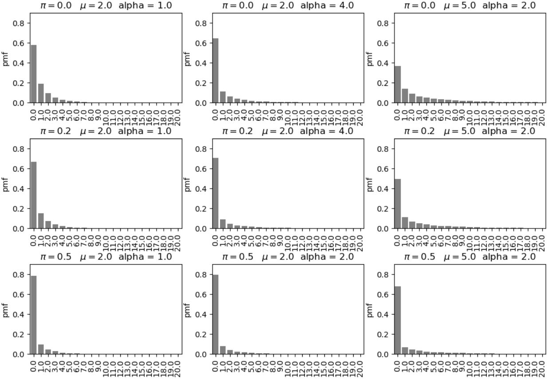
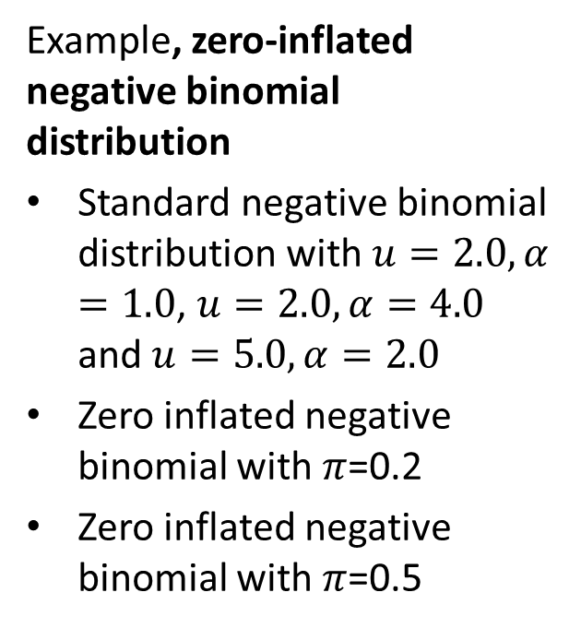
Zero-Inflated Negative Binomial Distribution
Example, zero-inflated negative binomial distribution
Standard negative binomial distribution with $u=2.0, α=1.0$, $u=2.0, α=4.0$ and $u=5.0,α=2.0$
Zero inflated negative binomial with $π$=0.2
Zero inflated negative binomial with $π$=0.5

Slide 31
Example: Zero-Inflated Poisson Regression
Example: model for fish caught by parties visiting a park
The distribution is zero inflated, many parties do not catch any fish
There is a strong right skew, some parties catch large numbers of fish – over-dispersion!

Slide 32
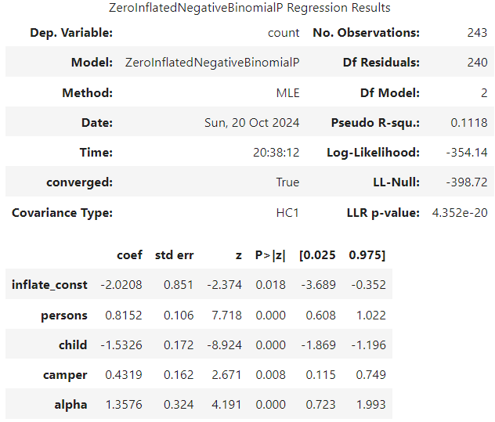
Example: Zero-Inflated NB Distribution Regression
Example: The zero-inflated Poisson regression model for fish caught showed significant over-dispersion
Try zero-inflated negative binomial distribution regression
Log-likelihood increased from -542 for zero-inflated Poisson regression
All coefficients are significant
The inflation coefficient has a large standard error and wide CI!
Significant over-dispersion coefficient
Adds 1 extra parameter to model compared to zero-inflated Poisson

Slide 33
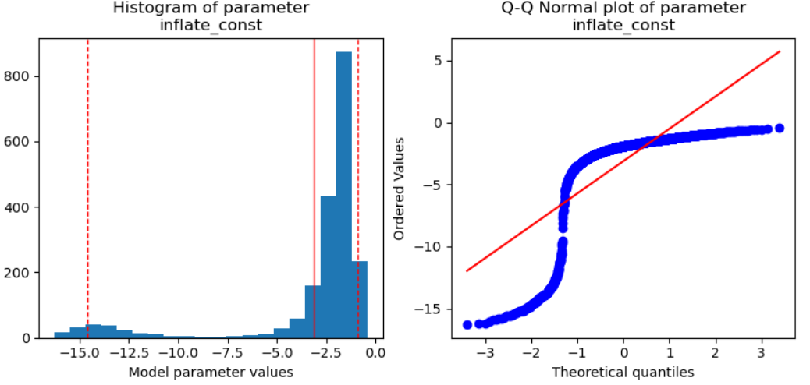
Example: Zero-Inflated NB Distribution Regression
Example: Compare zero-inflated negative binomial distribution regression to zero-inflated Poisson regression
The distribution of the over-dispersion coefficient is far from Normal
Distribution is bimodal with asymmetric CI
Perhaps a Bayesian model would have been a better choice?

Slide 34
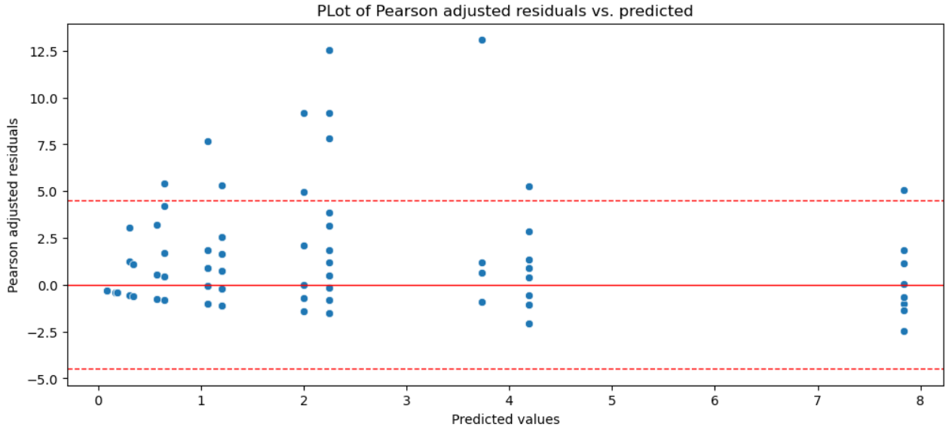
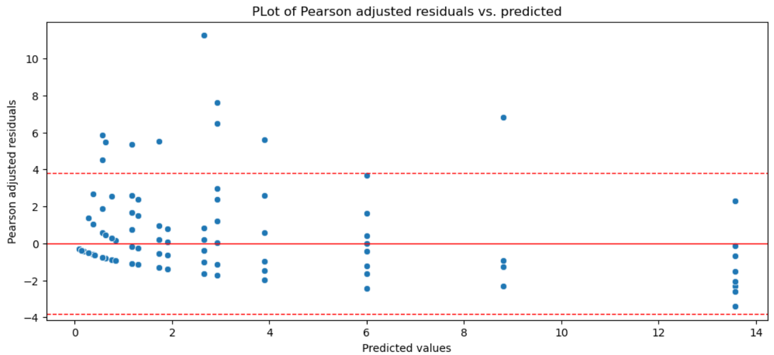
Example: Zero-Inflated NB Distribution Regression
Example: Compare zero-inflated negative binomial distribution regression to zero-inflated Poisson regression
Residual plots are similar, with noticeable outliers
Both models exhibit a bit of heteroskedasticity
Heteroskedasticity near zero could be result of poor fit of binomial parameter
Zero-inflated Poisson regression
Zero-inflated NB distribution regression

Slide 35
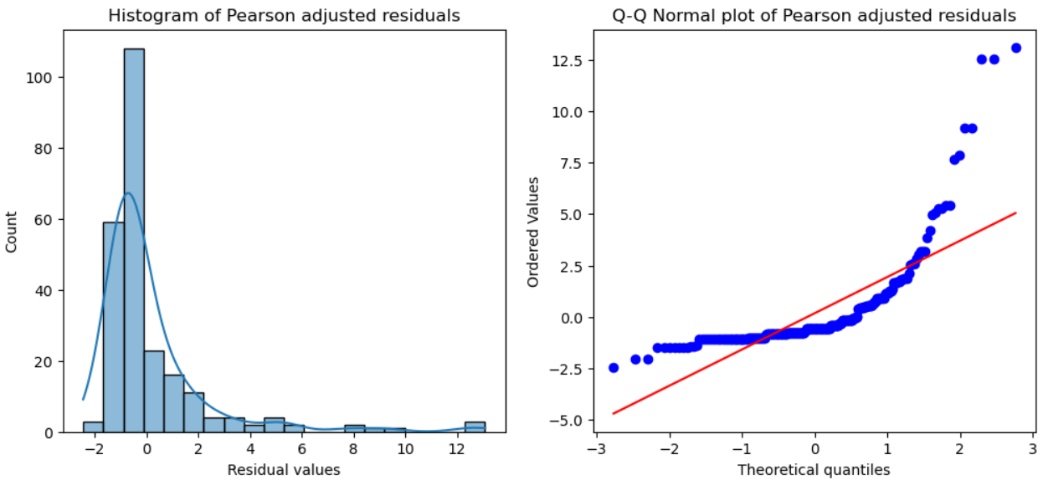
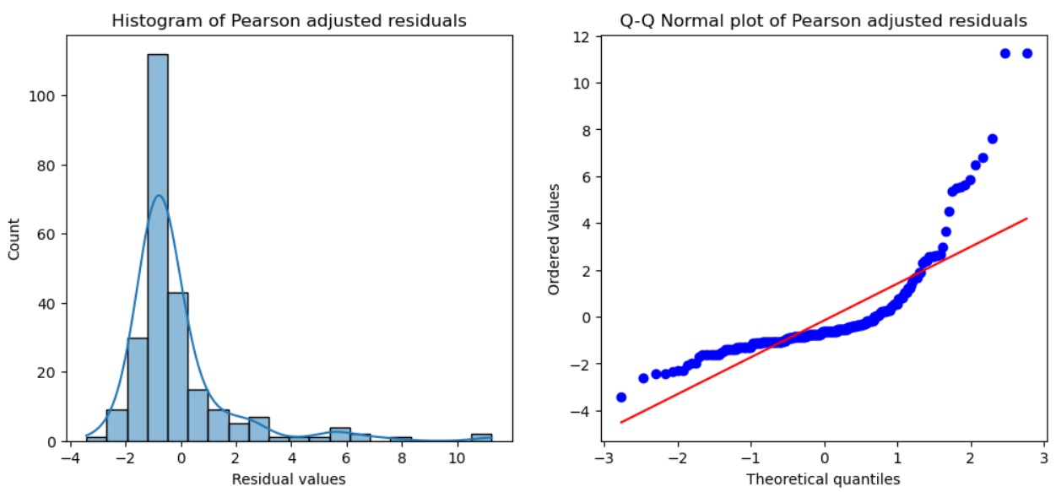
Example: Zero-Inflated NB Distribution Regression
Example: Zero-inflated negative binomial distribution regression for fish caught
Dispersion of residuals is a slightly less for NB distribution regression
Bulk of residual distribution more symmetric for NB regression
Notice the greater fraction in straight line (e.g. Normal) for NB distribution
Zero-inflated Poisson regression
Zero-inflated NB distribution regression

Slide 36
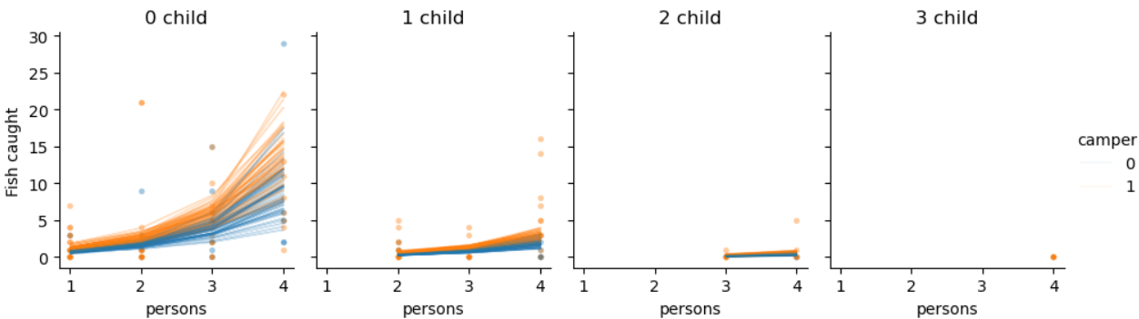
Example: Zero-Inflated NB Distribution Regression
Example: Zero-inflated negative binomial distribution regression for fish caught
Bootstrap resamples of the NB distribution regression
General behavior is reasonable, but wide dispersion of outcomes
Notice outliers that affect the model fit

Slide 37
Dealing with Outliers

Slide 38
Dealing With Outliers
Outliers are a persistent problem with statistical and machine learning models
What are outliers?
Errors or noisy measurement values
Extreme events not accounted for in model
But, outliers may be of greatest interest!
May need to explicitly model
Example: Fraud detection
Example: Scientific discovery
Outliers can be hard to detect
Difficult in high-dimensions
Often find by influence on model

Slide 39
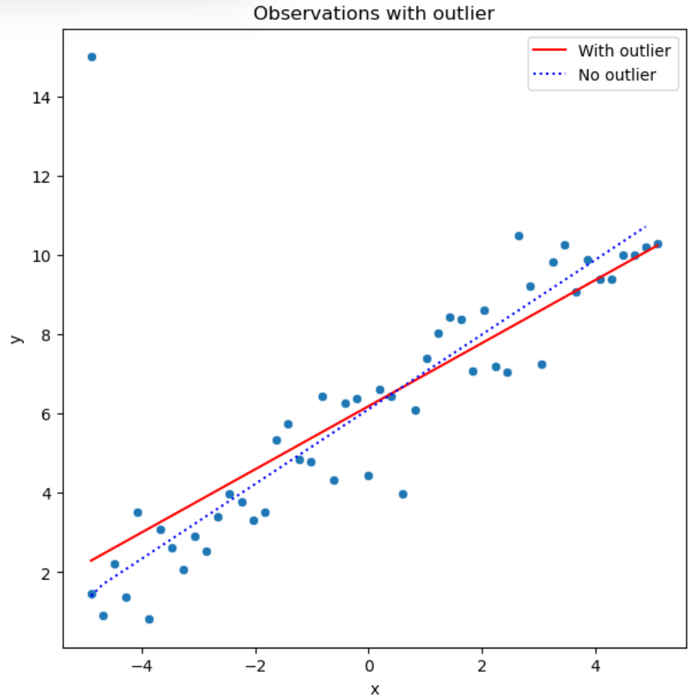
Effects of Outliers
Example: OLS regression with and without a single outlier
Add a single outlier with high leverage to the regression data set
Regression without the outlier represents the bulk of the data well
The regression line with the outlier is skewed with respect to the bulk of the data

Slide 40
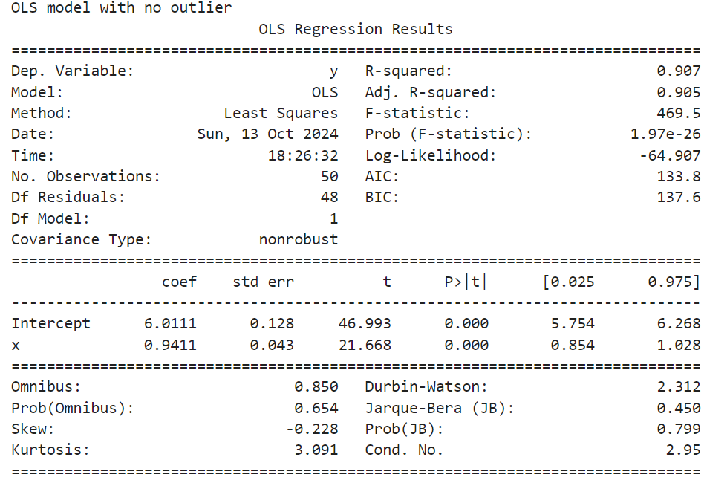
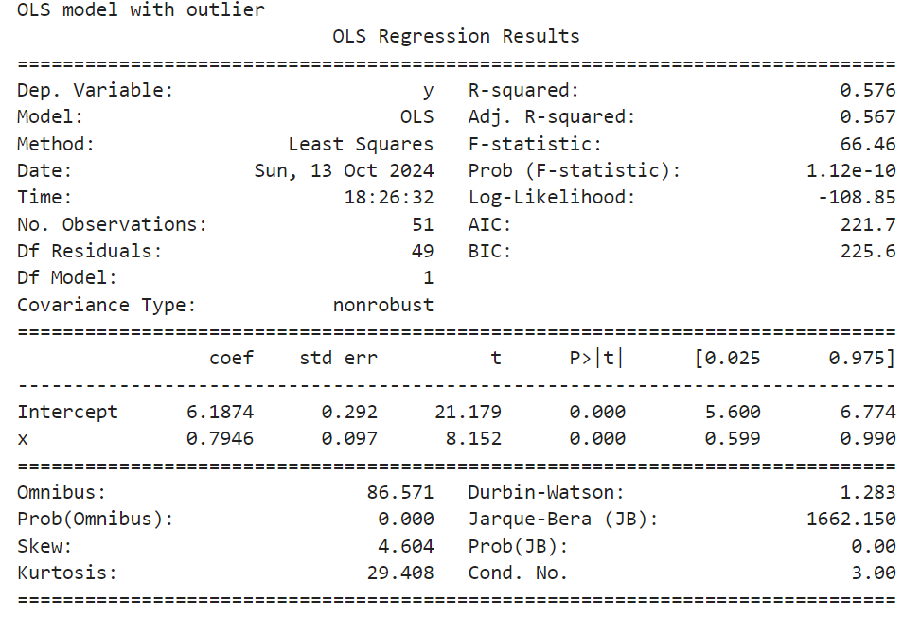
Effect of Outliers
Example: OLS regression with and without a single outlier
Intercept has only small change
Slope is noticeably changed
Changes are not statistically significant

Slide 41
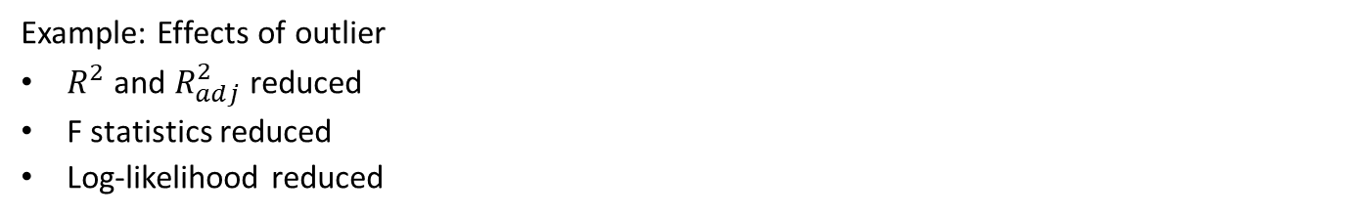
Effect of Outliers
Example: Effects of outlier
$R^{2}$ and $R_{adj}^{2}$ reduced
F statistics reduced
Log-likelihood reduced

Slide 42
Measuring Influence of Outliers
There are several measures we can use to understand outliers
Residual distance, the difference between observed and model response
Leverage, a measure of distance of an observation from the mean of the independent variables
Influence and Cooke’s distance, the change in the response from leaving out an observation when fitting the model

Slide 43
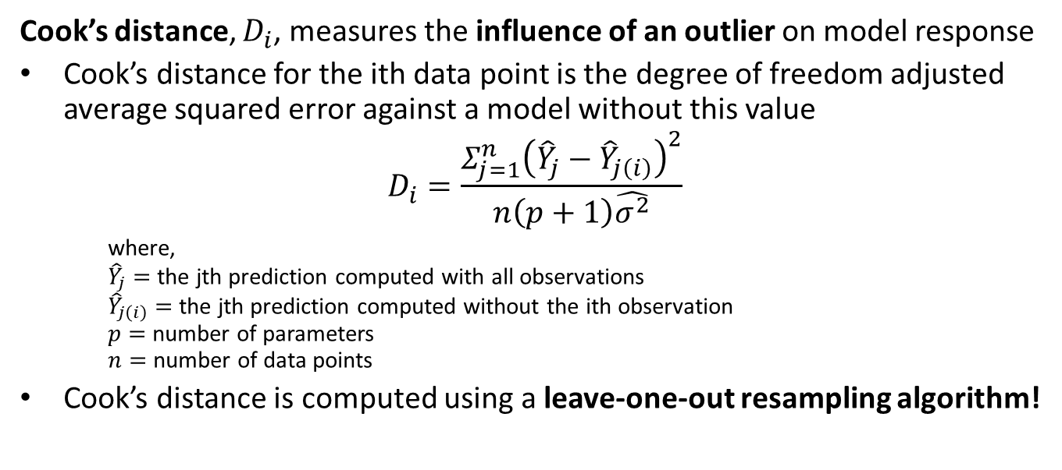
Measuring Influence of Outliers
Cook’s distance, $D_{i}$, measures the influence of an outlier on model response
Cook’s distance for the ith data point is the degree of freedom adjusted average squared error against a model without this value
$$D_{i}=\frac{Σ_{j=1}^{n}{\left({\hat{Y}}_{j}−{\hat{Y}}_{j\left(i\right)}\right)}^{2}}{n\left(p+1\right)\hat{σ^{2}}}$$
where, ${\hat{Y}}_{j}=$ the jth prediction computed with all observations ${\hat{Y}}_{j\left(i\right)}=$ the jth prediction computed without the ith observation $p=$ number of parameters $n=$ number of data points
Cook’s distance is computed using a leave-one-out resampling algorithm!

Slide 44
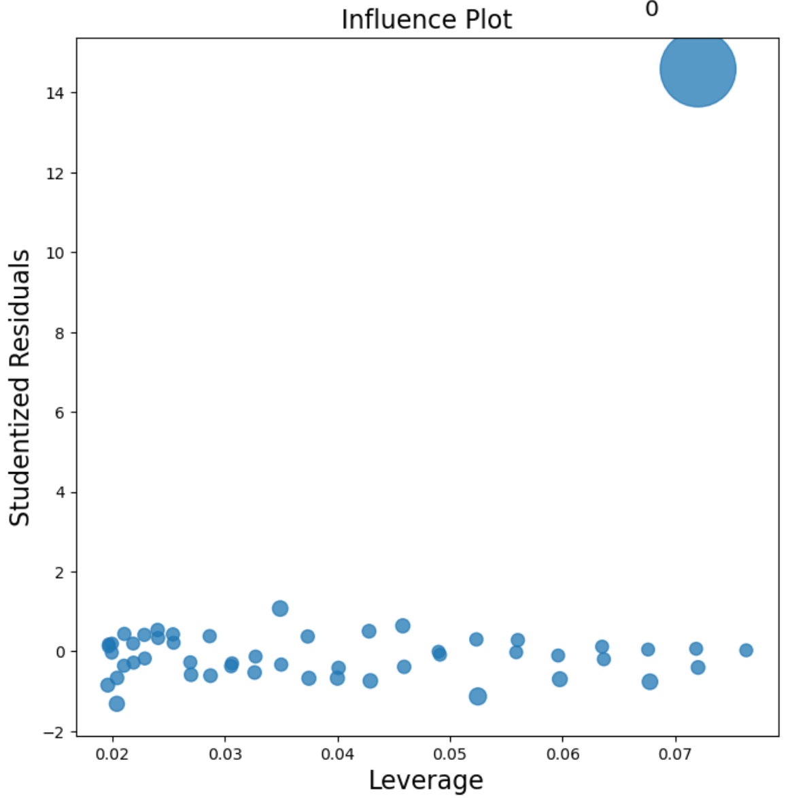
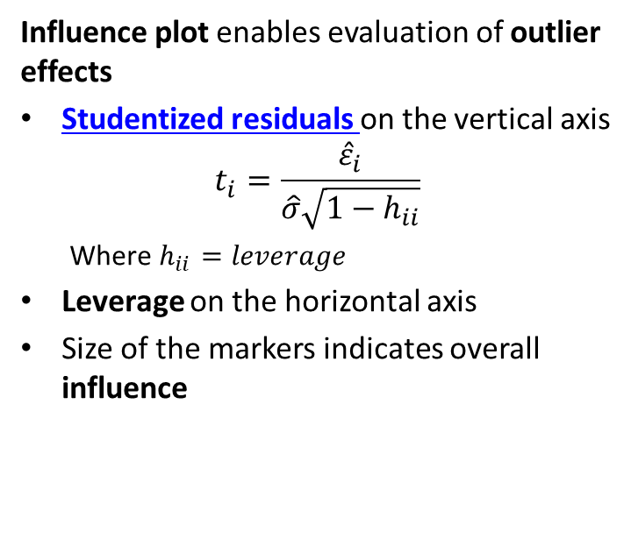
Measuring Influence of Outliers
Influence plot enables evaluation of outlier effects
Studentized residuals on the vertical axis
$$t_{i}=\frac{{\hat{ε}}_{i}}{\hat{σ}\sqrt{1−h_{ii}}}$$
Where $h_{ii}=leverage$
Leverage on the horizontal axis
Size of the markers indicates overall influence

Slide 45
Robust Models and Influence Function
We can measure the sensitivity of a model by its influence function
Example: Ordinary linear regression uses squared error loss function
Optimal if the errors are iid Normal
Is an unbiased estimator
But the influence function is unbounded!
Robust models have bounded influence function

Slide 46
Robust Models and Influence Function
Example: compare robust and non-robust model
Ordinary linear regression uses squared error loss function
Optimal if the errors are iid Normal
Has unbounded influence function
In 1-dimension, median is robust to outliers
A high bias estimator
Difficult to implement beyond 1-dimension
Bounded influence function
We can compare the response of estimators to outliers by comparing their influence functions

Slide 47
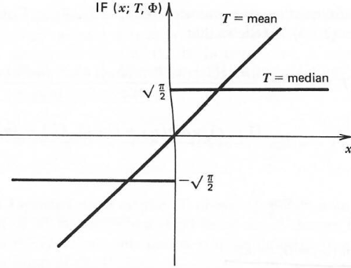
Robust Models and Influence Function
Compare the influence functions of the mean and median estimators
Mean estimator has linear influence function
Influence of outliers is unbounded
Derivative of the influence function is constant
Influence function of median estimator is discontinuous
Influence of any observation is bounded and constant
Derivative of influence function is not defined at 0
Influence functions for mean and median
Figure from Hampel, el.al., Robust Statistics, 1986

Slide 48
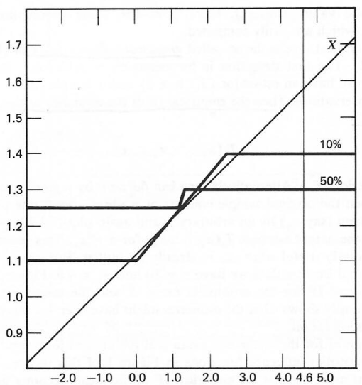
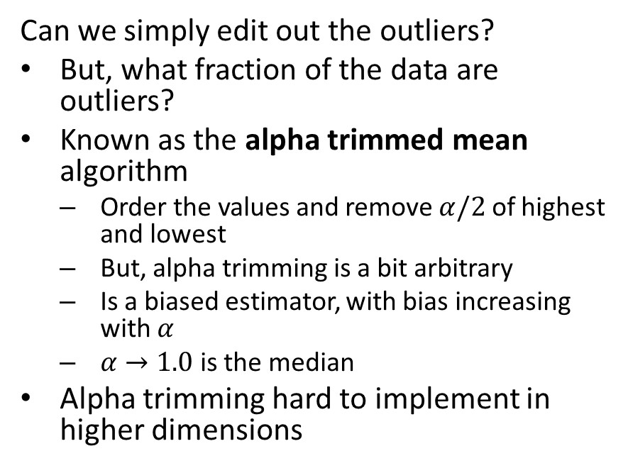
Dealing With Outliers
Can we simply edit out the outliers?
But, what fraction of the data are outliers?
Known as the alpha trimmed mean algorithm
Order the values and remove $α/2$ of highest and lowest
But, alpha trimming is a bit arbitrary
Is a biased estimator, with bias increasing with $α$
$α→1.0$ is the median
Alpha trimming hard to implement in higher dimensions
Influence functions for alpha trimmed mean
Figure from Hampel, el.al., Robust Statistics, 1986
Figure from Hampel, el.al., Robust Statistics, 1986

Slide 49
Dealing With Outliers
Are there better robust estimators?
Yes, but must accept some bias
Idea; estimator can be unbiased near the expected value
Limit influence of outliers
Trade-off between high robustness and low bias
Many ideas have been tried
A major research focus in the 1970s and 1980s
Huber estimator
Family of M-estimators

Slide 50
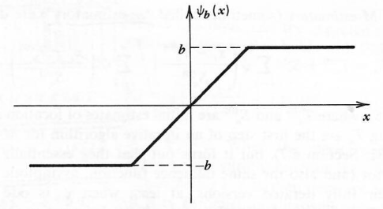
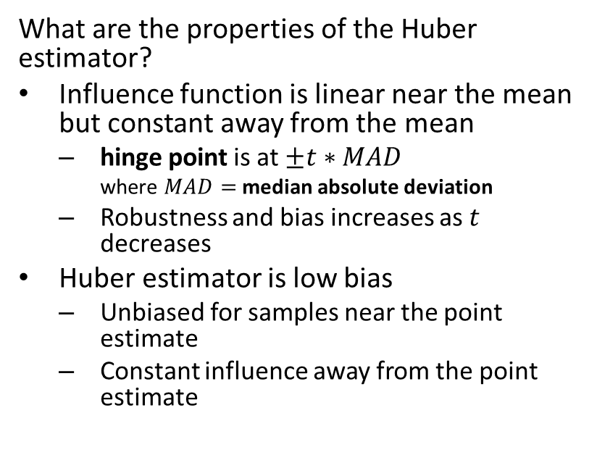
Dealing With Outliers
What are the properties of the Huber estimator?
Influence function is linear near the mean but constant away from the mean
hinge point is at $±t∗MAD$
where $MAD=$ median absolute deviation
Robustness and bias increases as $t$ decreases
Huber estimator is low bias
Unbiased for samples near the point estimate
Constant influence away from the point estimate
Influence function of the Huber estimator
Figure from Hampel, el.al., Robust Statistics, 1986

Slide 51
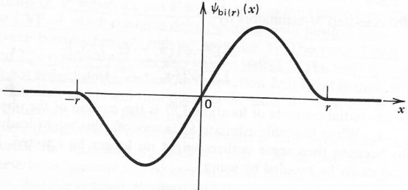
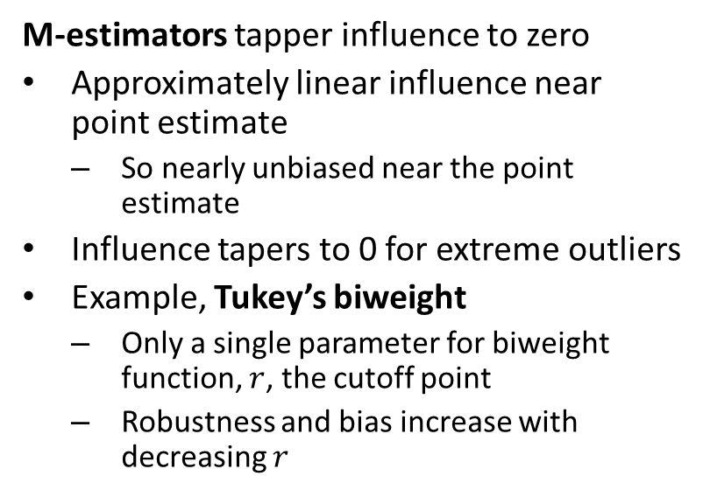
Dealing With Outliers
M-estimators tapper influence to zero
Approximately linear influence near point estimate
So nearly unbiased near the point estimate
Influence tapers to 0 for extreme outliers
Example, Tukey’s biweight
Only a single parameter for biweight function, $r$, the cutoff point
Robustness and bias increase with decreasing $r$
Influence function of the Tukey’s Biweight M-estimator
Figure from Hampel, el.al., Robust Statistics, 1986

Slide 52
Example: Dealing With Outliers
Example: regression with Huber loss function
## Define the robust regression model and fit it to the data ols_model_huber = smf.rlm(formula ='y~x', data = sim_data_ol).fit() # Add predicted to pandas data frame sim_data_ol['predicted_huber'] = ols_model_huber.predict(sim_data_ol.x) ## Display sumamry ols_model_huber.summary()

Slide 53
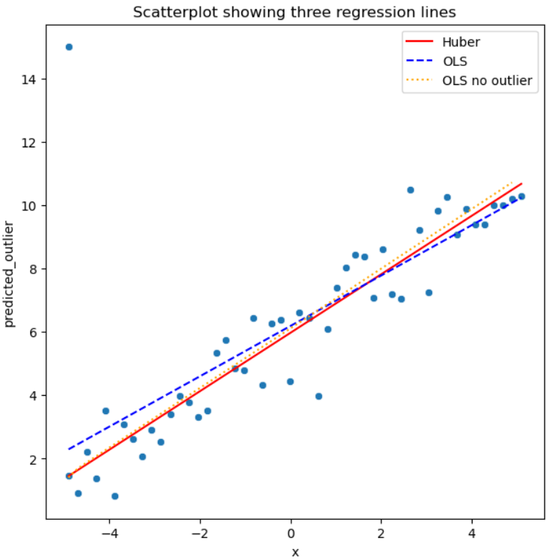
Example: Dealing With Outliers
Example: Comparing regression Results
Regression line with no outlier is benchmark
OLS fit shows influence of single outlier
Huber loss regression is nearly the same as OLS with no outlier

Slide 54
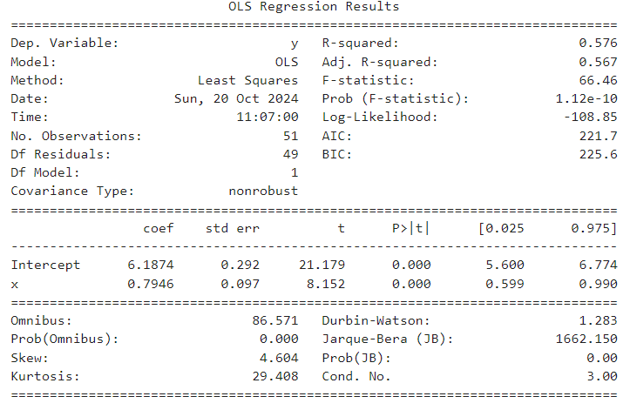
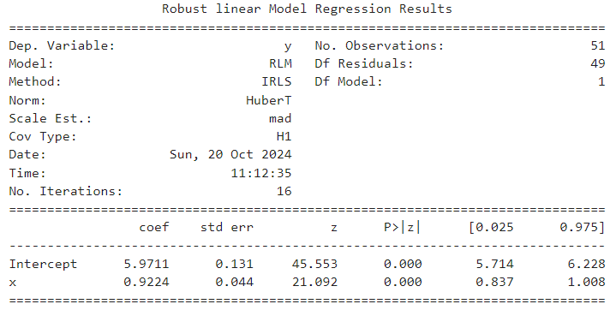
Example: Dealing With Outliers
Example: Comparing regression Results
The slope coefficients are noticeably different
CIs of intercept and slope coefficient are reduced in robust model
From the confidence intervals the differences are not statistically significant
Summary of OLS regression
Summary of Huber regression

Slide 55
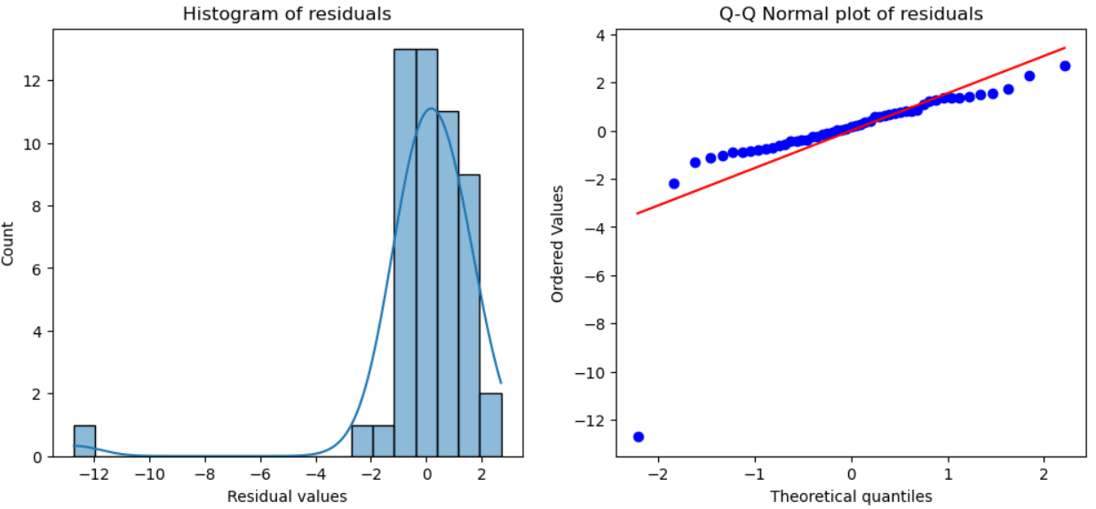
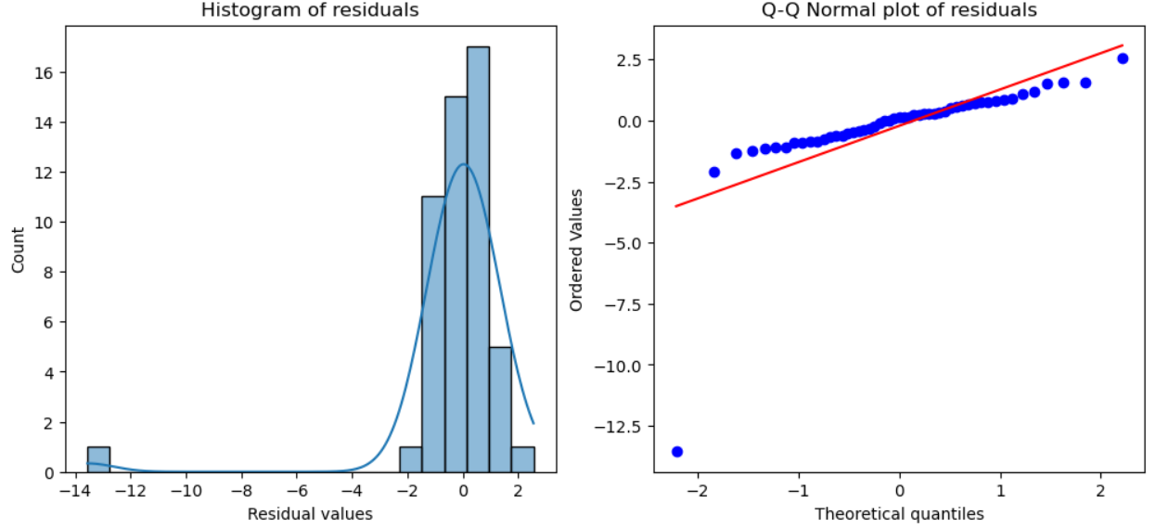
Example: Dealing With Outliers
Example: Comparing regression Results
The residuals are nearly identical for the two models
The residuals are near normal except of an obvious outlier
Note the near straight line of the quantiles in the Q-Q plots
Residuals of OLS regression
Residuals of Huber regression

Slide 56
Summary
Several commonly encountered data problems create problems for OLS and GLM models
Zero inflated response variables have an unusual number of zero values
Use a mixture model to switch between a binomial and another distribution
Over-dispersed response variables have a long (typically right) tail
Apply models with distributions and mixtures that account for large low probability responses
Outliers in independent variables have an undue influence on OLS and GLM models
Robust regression models limit the influence of outliers on the response

